Slide 1






How can our school support students and people impacted by a loved one's imprisonment?
A Journey Into Prison
Staying in Touch
The impact of imprisonment
Brandon's Story
Around 7% of school age children experience the imprisonment of their father
Every day, there are an estimated 100,000 children with a parent in prison

Slide 2


The impact of imprisonment

Slide 3




Slide 4
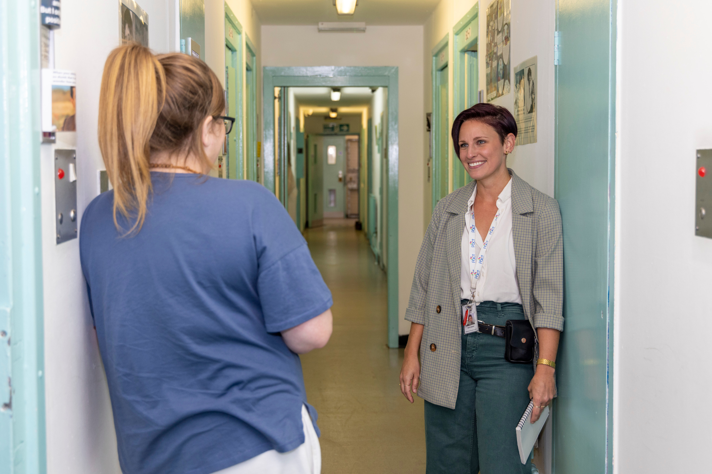

  There are roughly 85,420 people in prison in England and Wales (July 2023) - about 5% of these are women.
  There are an estimated
200,000 - 300,000 children with
a parent in prison in England
and Wales
  Around 7% of school-age children experience the imprisonment of their father

Slide 5
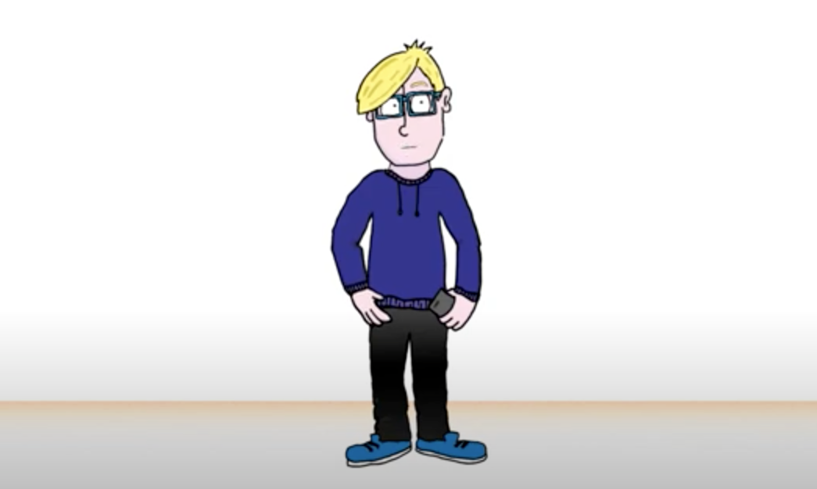

Brandon’s
Story

Slide 6
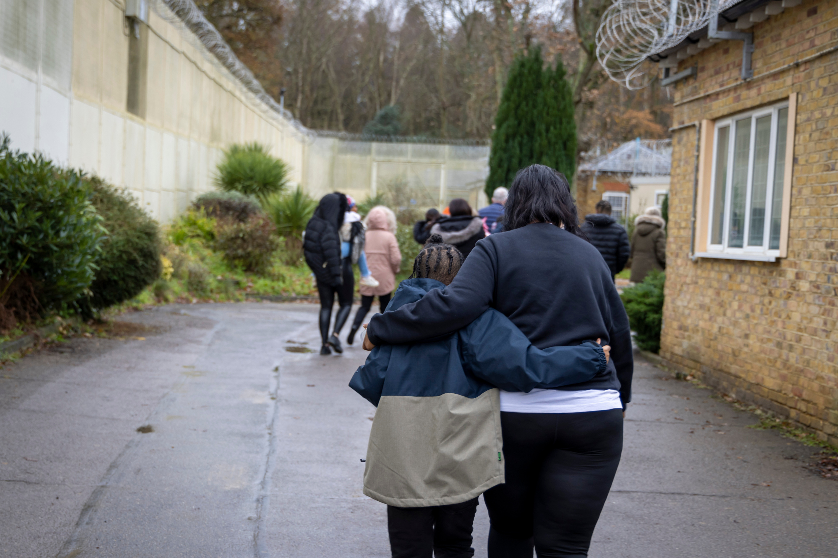

What can we do together as a school to support our pupils, friends, and peers who are affected by the imprisonment of a loved one?

Slide 7
Staying in touch

Slide 8



www.prisonadvice.org.uk

